Slide 1
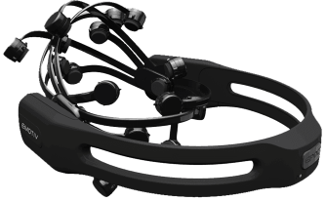
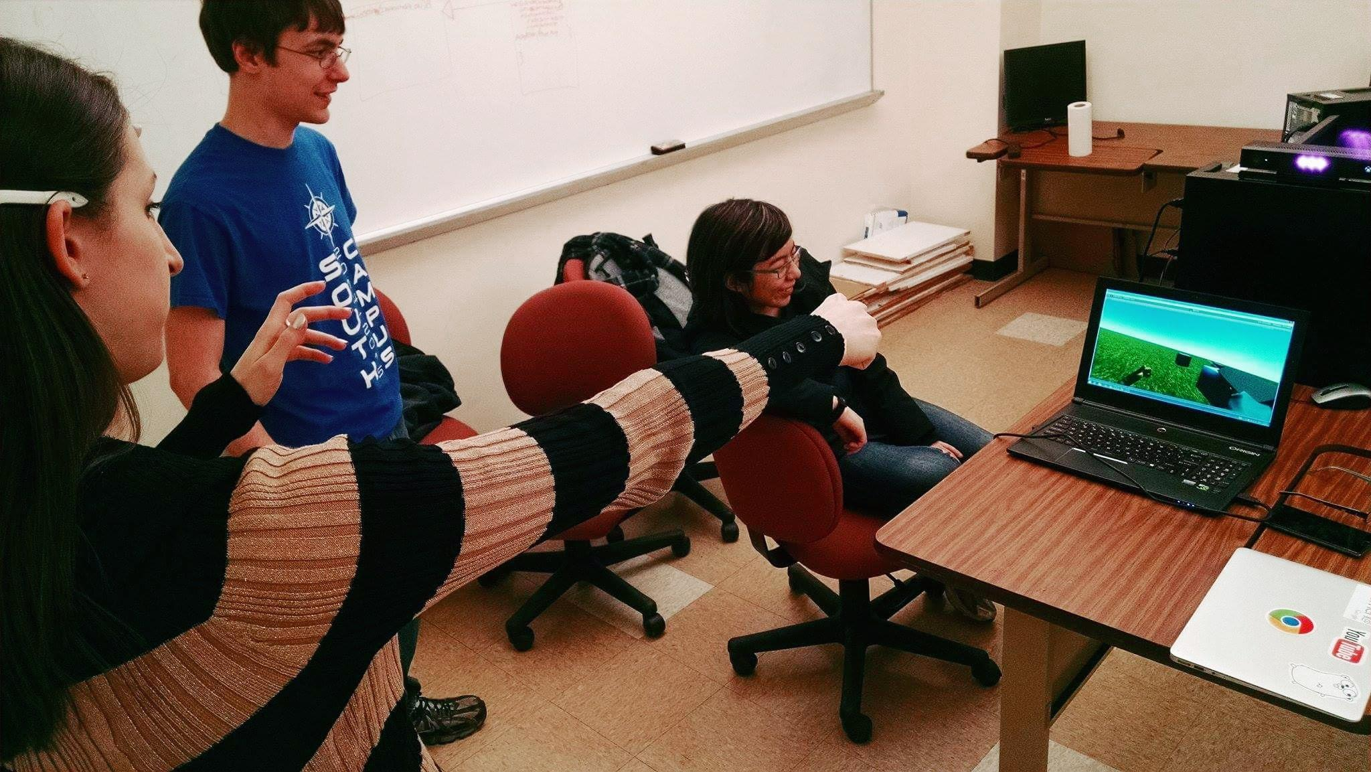
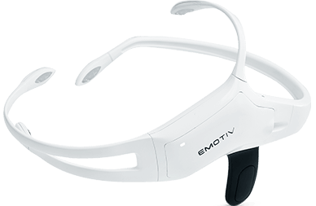
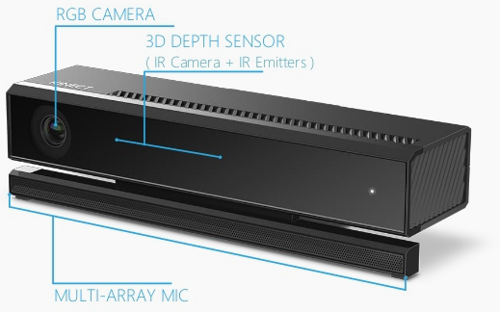
Team 2: Wireless Electroencephalographic Device
Sponsored By:
Sponsor Advisor:
Faculty Advisor:
Team Members:
Introduction
System Overview
Electroencephalographs (EEGs) are input devices available as commercial wireless headsets which are capable of picking up signals associated with facial expressions, emotions, or even focused thoughts. These could be used by physically impaired people (e.g., paraplegics or victims of ALS) or the non-disabled to control external devices or software such as video games.
Client
Key
Emotiv-JSON API Server (jar)
affective, cognitive
Emotiv SDK libraries
<playerName>
Port 4444
EEG data
(stream)
<affective, cognitive data> (stream)
time
Port 4445
train <command>
<training status>
Objective
EEG data
Emotiv-JSON
API
Cognitive profile management requests
Create a new paradigm of gaming using Emotiv EEG input
Makes the game more psychologically involved through the use of mental commands
Could make the gaming — or any — experience more intuitive
Can be used to monitor a person’s emotions non-intrusively
Is an interesting way to teach people more about what signals their brains are sending
EEG data and requests
EPOC+ or Insight
Kinect SDK
Background
Emotiv EPOC+ is a brain-computer interface (BCI) capable of detecting up to 4 trained mental commands at a time, 12 facial expressions, 6 emotional states, and 9 axes of motion. It uses 16 saline-soaked felt pads for its sensors.
Emotiv Insight is another BCI that has similar detection capabilities as the EPOC+, however, it uses a long-life semi-dry polymer for each of its 7 sensors.
Kinect V2 is a natural user interface which utilizes an infrared array to track up to 6 players, heart rate, and speech.
Unity is a cross-platform engine used to develop video games.
RUIS (Reality-based User Interface System) used for controlling a character in Unity via a Kinect
The player can navigate around the game world using leaning/tilting of the head and then perform object selection using moving their arms and clenching their fist. Once an object is selected, thinking a mental command can make the object perform a certain action such as explode or be pulled toward the player.
Hardware
Discussion
Most of the problems we had involved incorporating Unity, Kinect and Emotiv. We used RUIS which maps the person’s movements seen within the Kinect to the player character in Unity.
We had a harder time getting Unity to work with the Emotiv. The client had to be written in C# since we were using Unity while the server was in Java. After we solved how to get data from the Emotiv, we had to look into how to send commands like “train neutral”.
The solution we came up with was using a thread and having it sleep right after sending the command instead of reading immediately from the socket. We found out that if we read when there’s no data, the program has a chance of hanging even if data comes in later on.
We also found out that we can’t train more than 3 commands total (including neutral) or the program will lag when trying to classify.
Emotiv Insight EEG headset
Emotiv EPOC+ EEG headset
Kinect V2 motion-tracking device for Xbox One

Slide 2
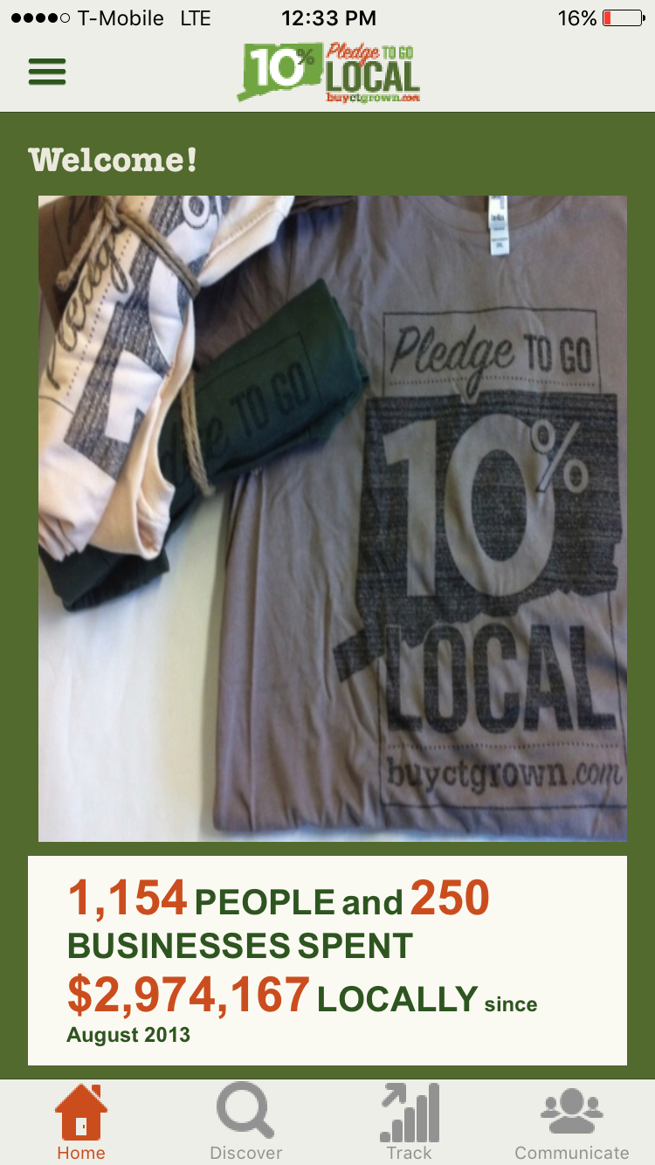
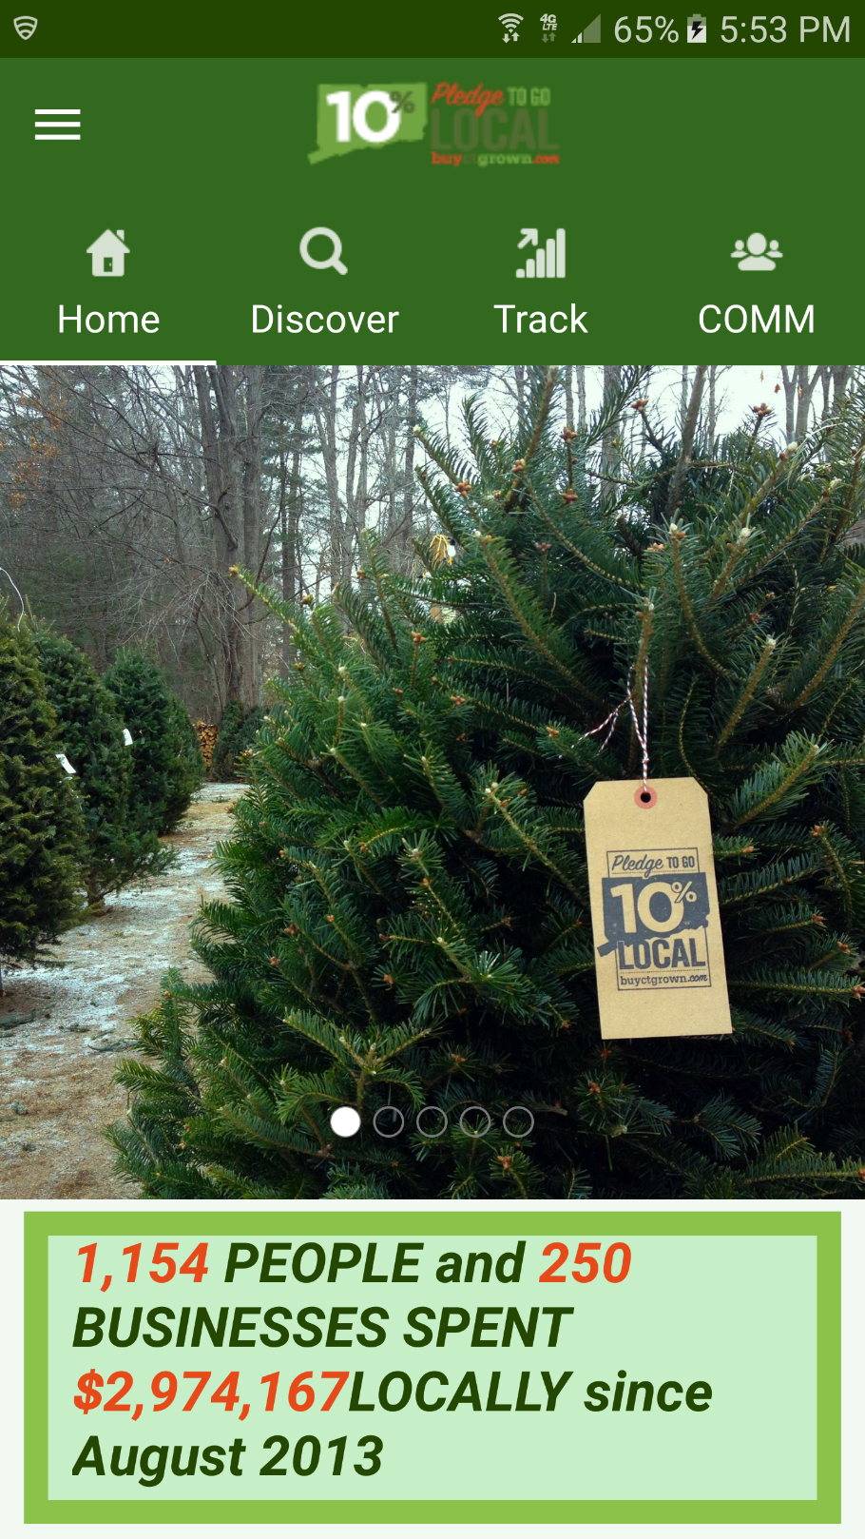
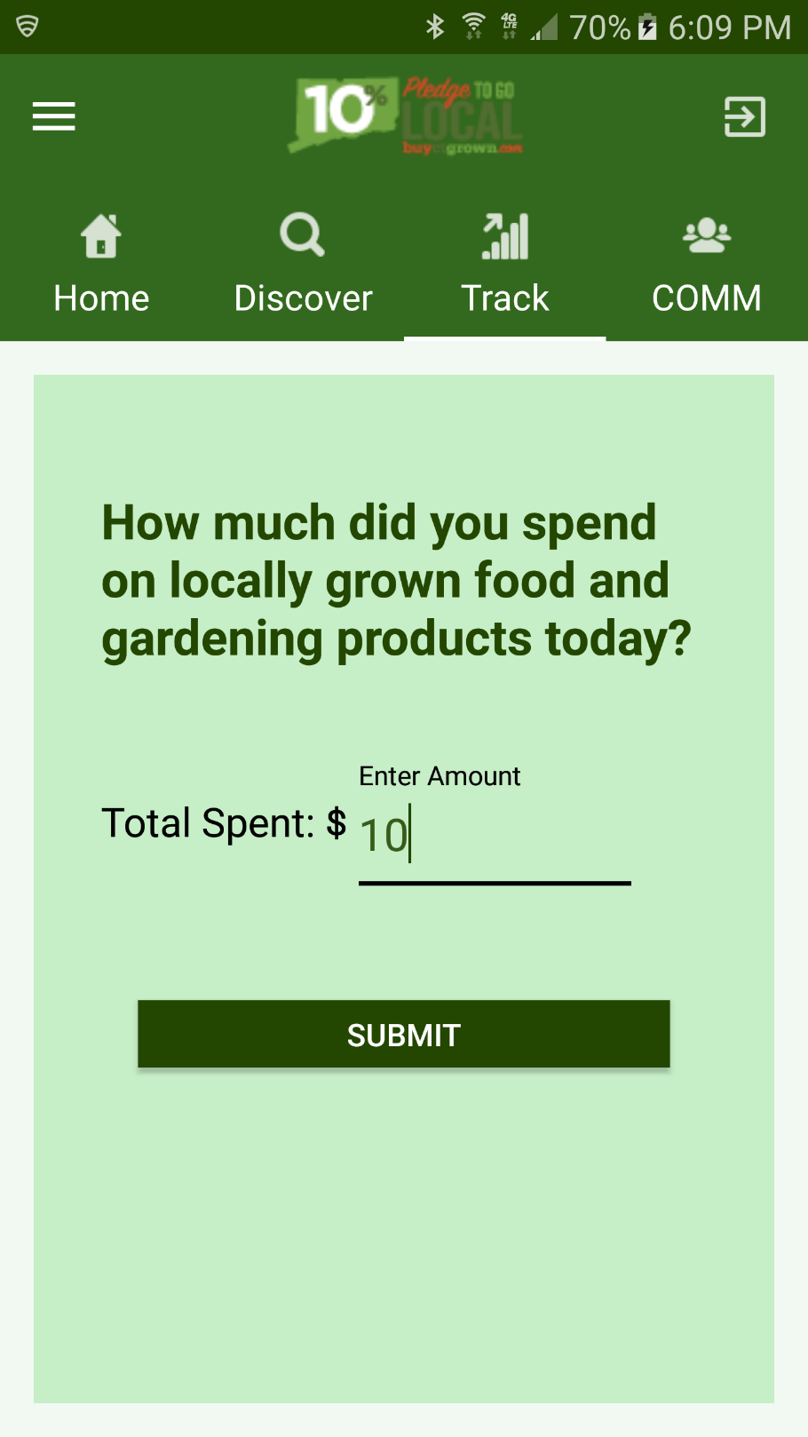
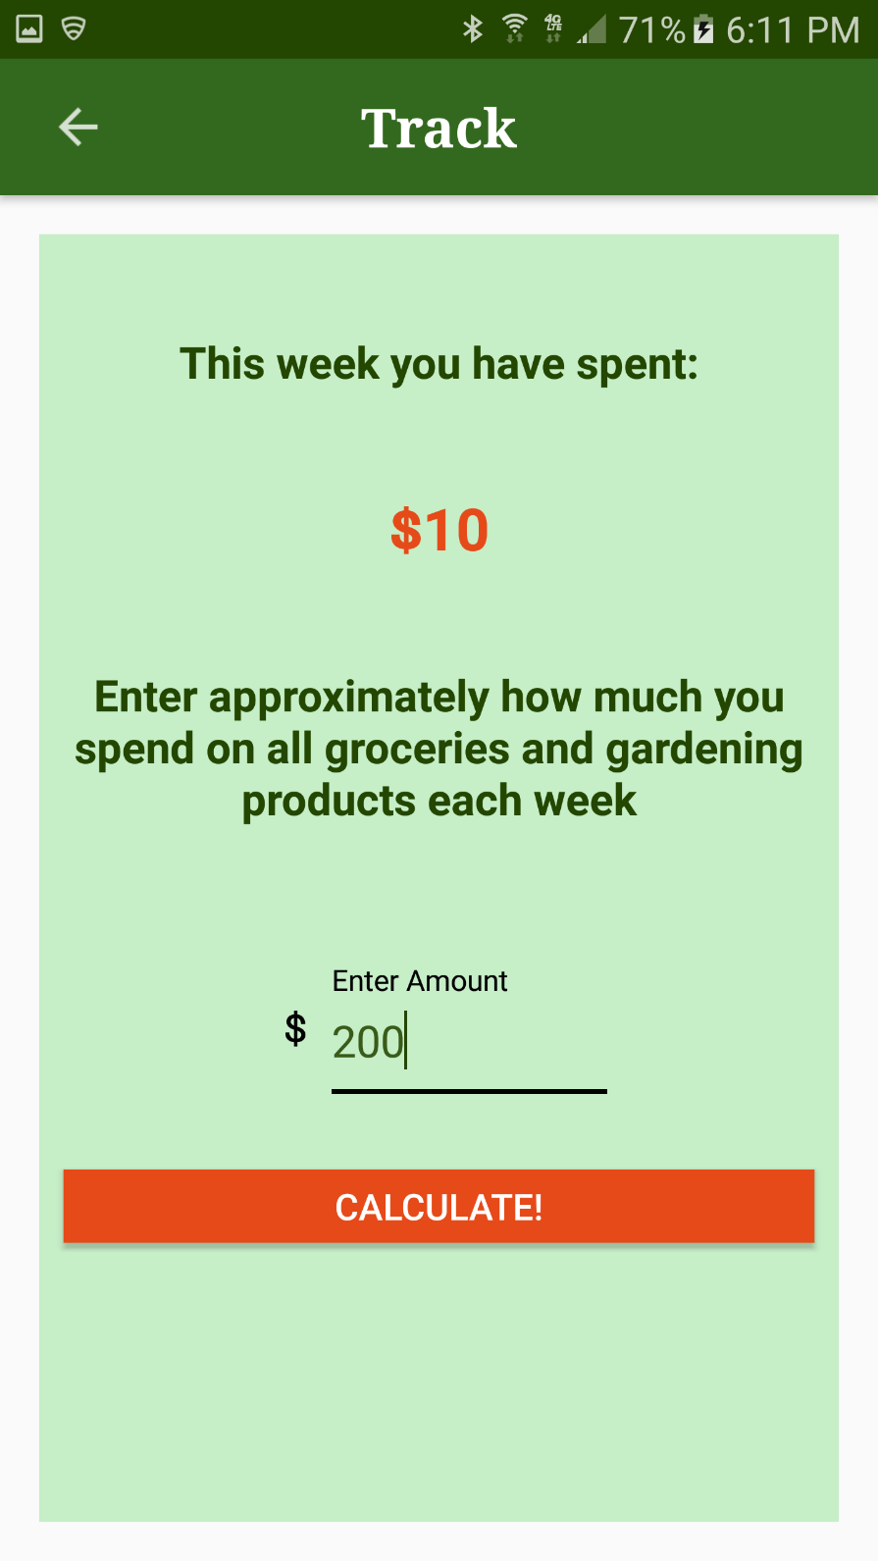
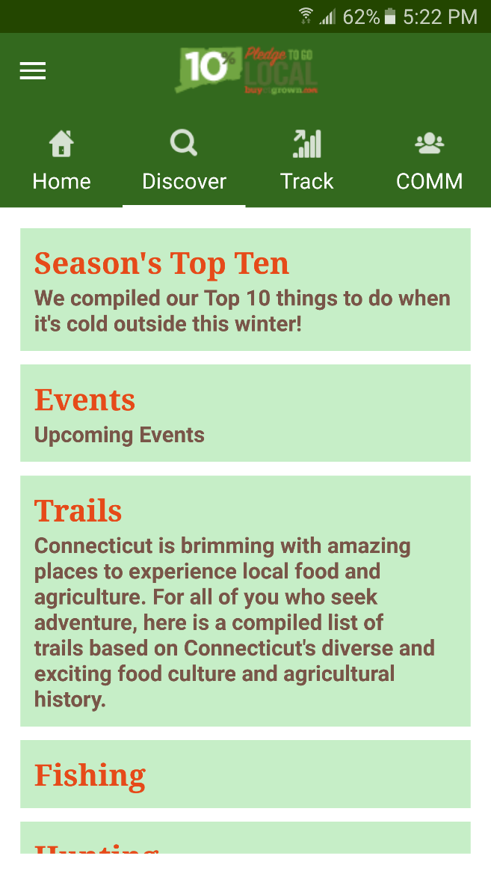
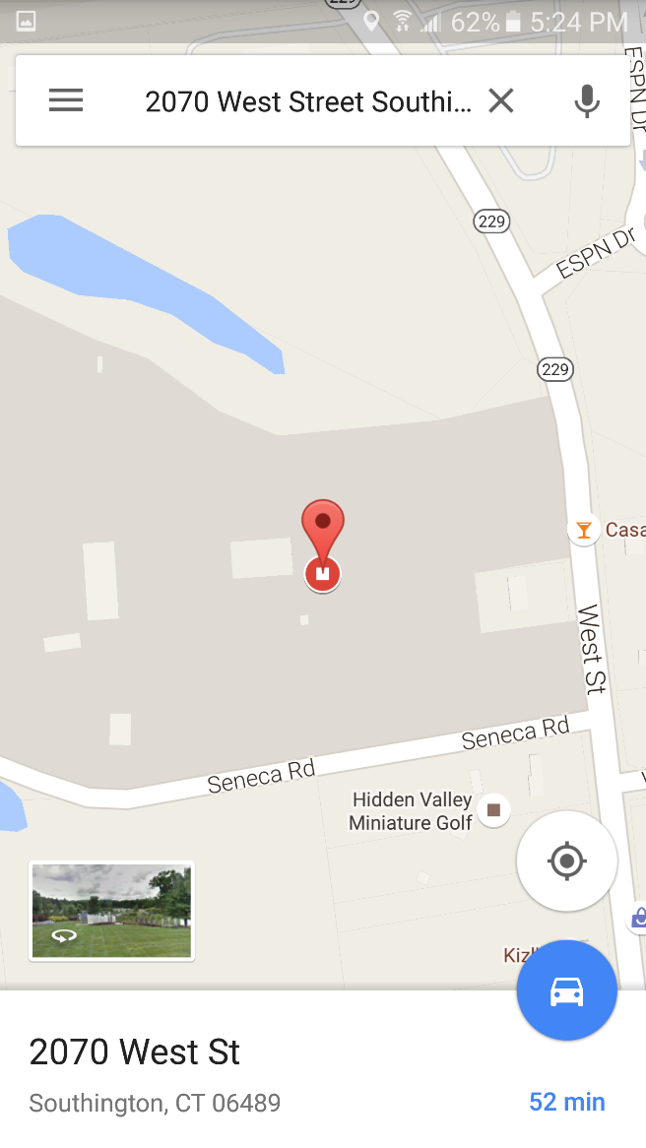
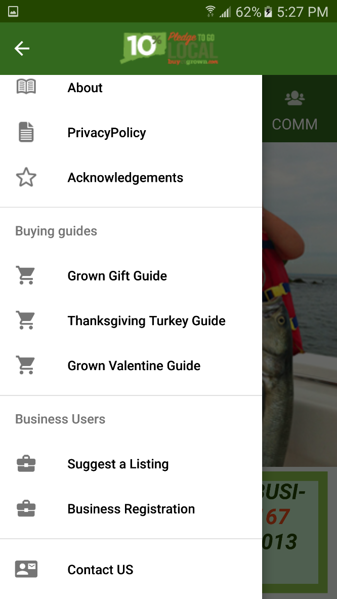
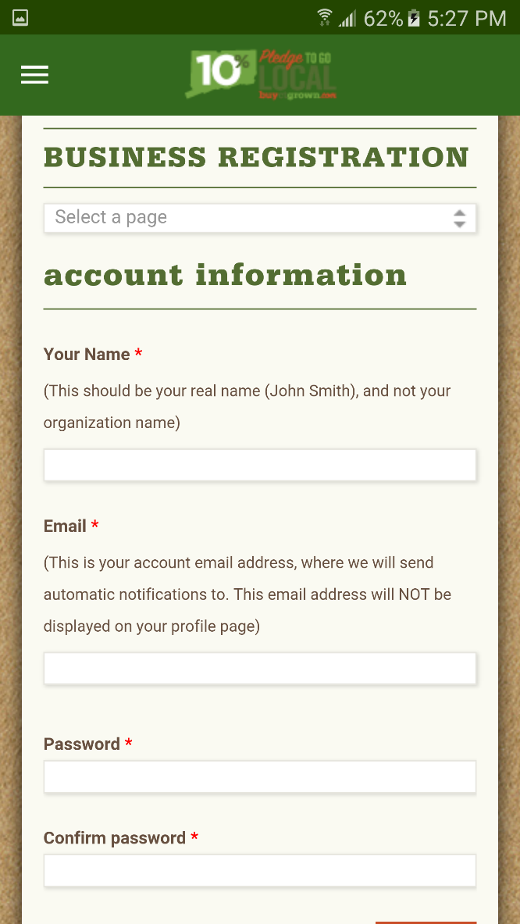
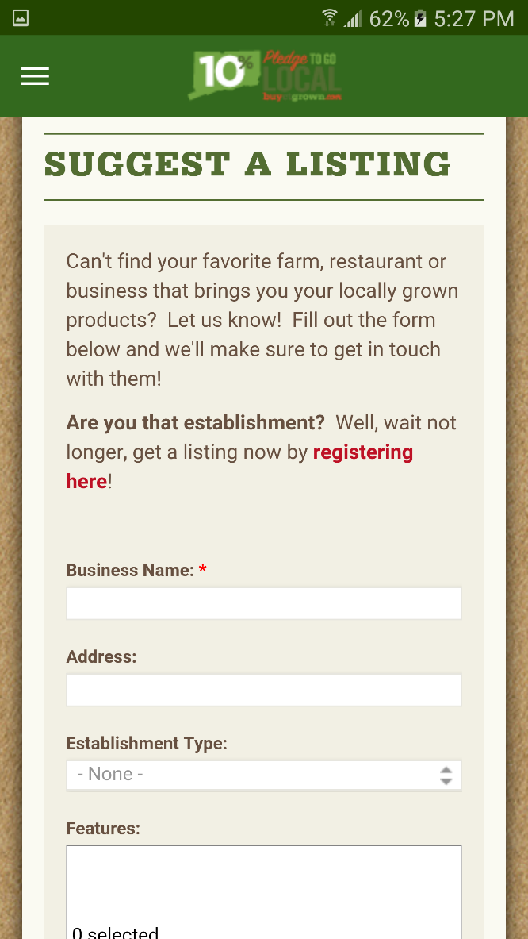
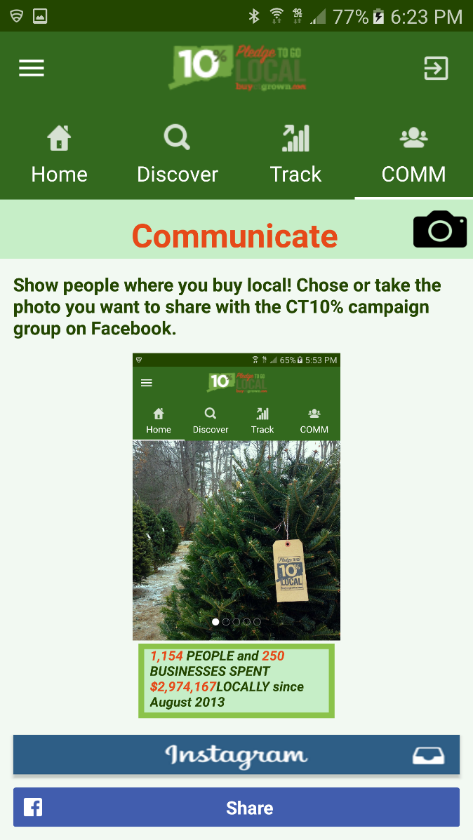
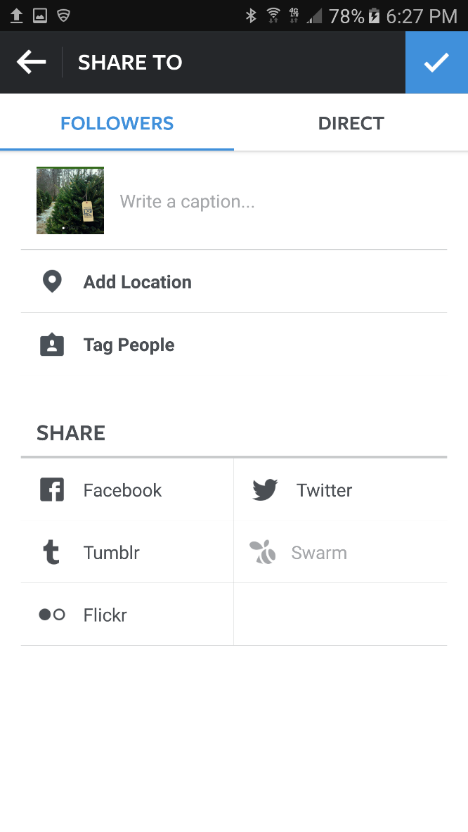
CT 10% Mobile App: Team 25
An Application to discover CT-Grown goods and experience local agriculture
Team members names need to be in this section
Sponsor Advisor:
Sponsored by:
Faculty Advisor:
Introduction and Motivation
Project Goals
The project is to develop a mobile application on the Android platform to accompany the iOS Live Local Mobile App for UConn Extension. UConn Extension is a department within the College of Agriculture, Health, and Natural Resources devoted to connecting the power of UConn research to solve local problems. One of our growing projects is engaging residents to support local farms and working landscapes. Through the CT 10% Campaign, residents and businesses are invited to take a pledge to spend 10% of their food and gardening dollars on locally grown products. The 10% Campaign is an online tool of agriculture service providers that are working together to help consumers discover local Agriculture, based at www.buyctgrown.com.
Engage local residents and businesses to support local farms and working landscapes.
Promote 10% Campaign.
Inform user’s of fun agricultural activities.
Provide medium between user’s and farm/business owners.
1. Mobile Applications
System Overview
2. Track and Report Progress
iOS
Android
Figure 2: Overview of the CT 10% App System Components
Figure 3: Track Screen
Figure 1: CT 10% mobile applications
The CT 10% Mobile App System is comprised of 6 Major Components:
On the track tab, user can put how much he has spent on locally grown products that day/week and then submit the form to report their progress. As shown in the screen, after the form submission user will be able to see how much he has spent on that week
Shows the image carousel, where the images are being downloaded from the server, related to locally grown products and also the real-time statewide stats of the CT10% campaign.
1. Mobile Applications | 2. Track and Report Progress | 3. Google Maps
4. Local Activities | 5. Business Users | 6. Social Media
3. Season’s Top Ten, Events, Trails
4. Business Users
5. Social Media
Figure 4: Discover Screen
Figure 5: Options for Business Users
Figure 6: Communicate Screen
Scrollable view on the right that contains the top ten items of the season, upcoming events shown on buyctgrown.com, list of trails available, and the information about fishing and hunting. The second screen shows detailed information of the chosen event while the third screen shows Google maps with a pin where the event is located. With this, the user can use the GPS to know how to get to the event form the location he inputs. All of information shown in these pictures was retrieved from the API.
Navigation Drawer on the right shows some options for business users. As shown in the second picture they register their business using our application, and if they already have a business account then as shown in third picture they can suggest a listing through our application.
As shown in the screenshots, on this tab user can take a picture or chose one from the gallery app of the locally grown products they bought and then post it on Facebook or Instagram.
Acknowledgements
Try it Now

